Slide 1
Java Class
Day 15

Slide 2





Jul
Aug
TOEIC(7/24) 6/6~7/11
TEPS(7/16) 6/29~7/12
TOEIC(8/07) 6/20~7/25
TOEIC(8/21) 7/ 4 ~ 8/ 8
TEPS (8/06) 6/20~7/17
TEPS (8/20) 7/ 4 ~7/31
Big Data Analyst(10/1)
8/29~9/2
ADsP(8.28) 8/1~8/5
www.toeic.co.kr
www.teps.or.kr
www.dataq.or.kr
austin.sogang.ac.kr
austiny.snu.ac.kr

Slide 3
Mon
Tue
Wed
Thu
1. Main
Fri
1. Recap Sub
2. Main
2.
3. Main
3.
4. Main
4.
LUNCH
LUNCH
5. Sub
5. Recap Main
6. Sub
6.
7. Sub
7.
8. Recap, Test
8. Test
Jul
Aug
Java Basic
HTML, CSS, JS
Java Intermediate
Database

Slide 4
Java

Slide 5
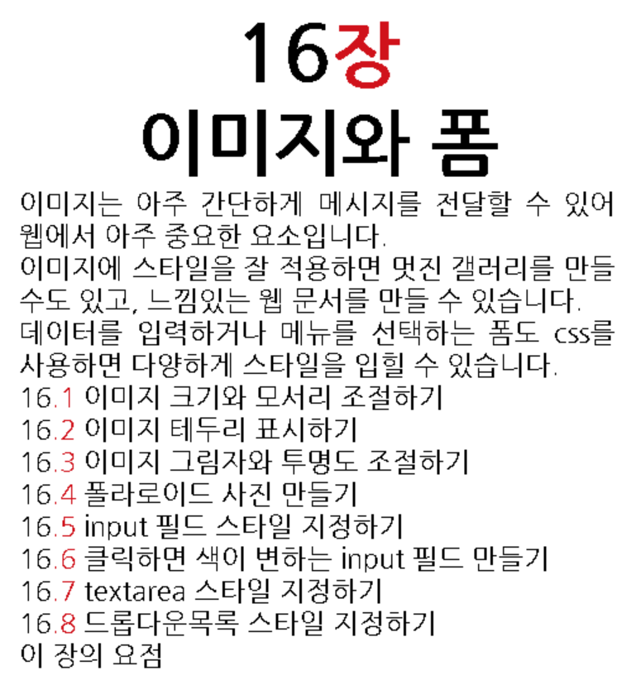
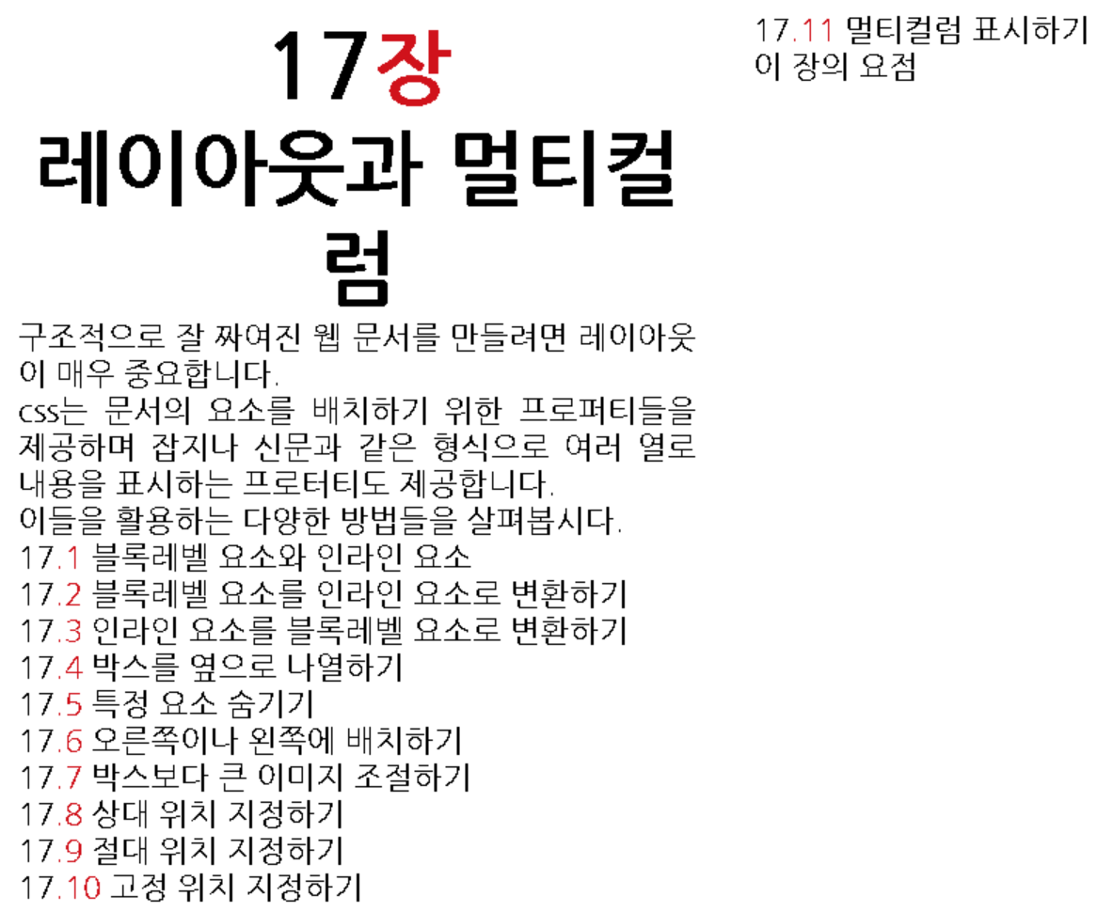
CSS

Slide 7
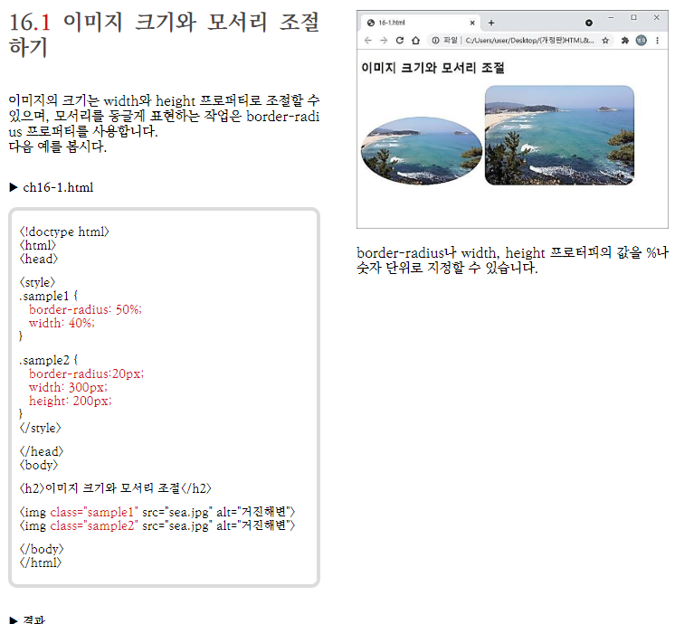

Slide 8
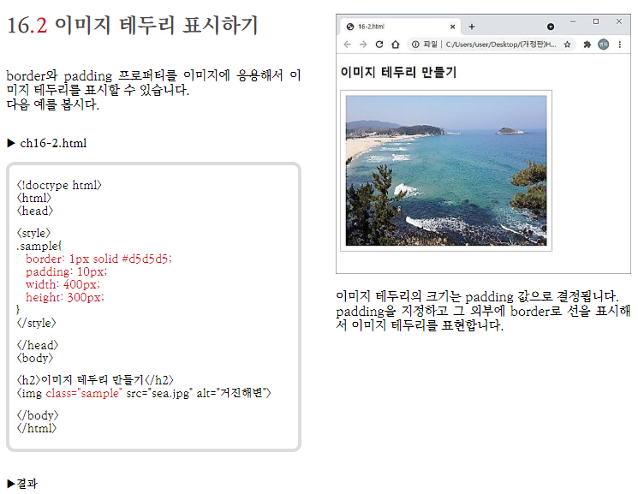

Slide 9
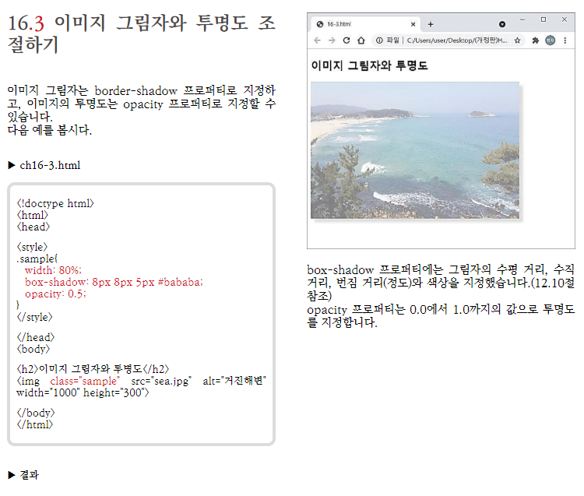

Slide 10
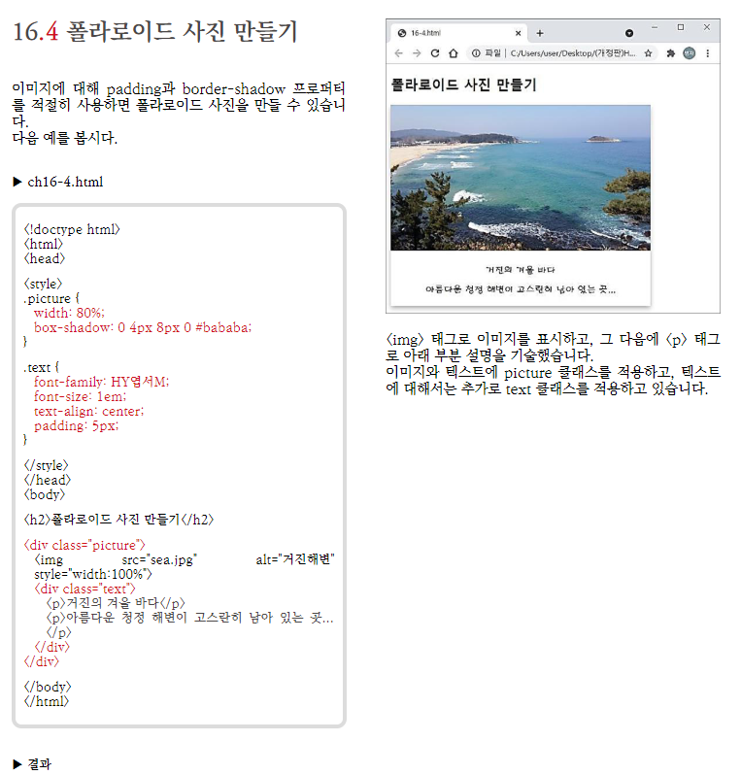

Slide 11
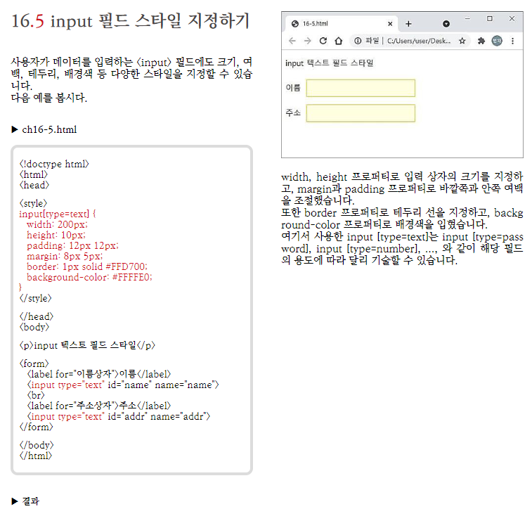

Slide 12
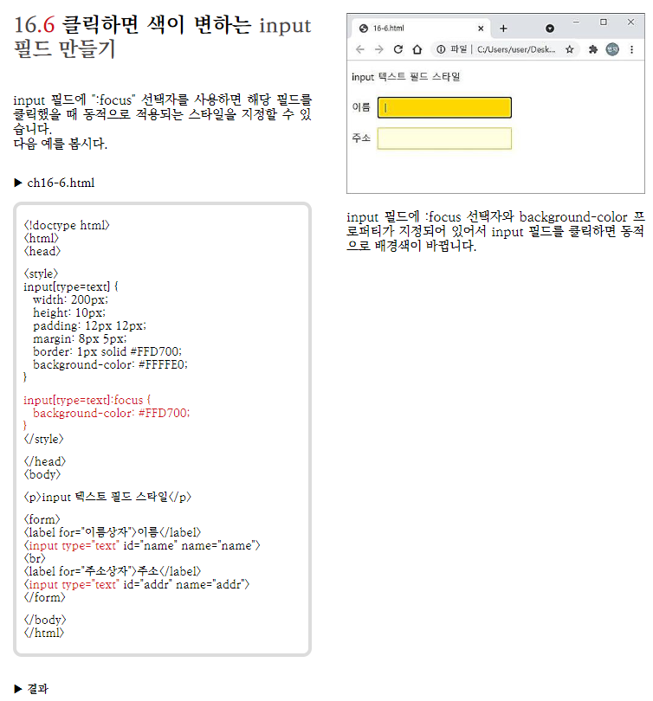

Slide 13
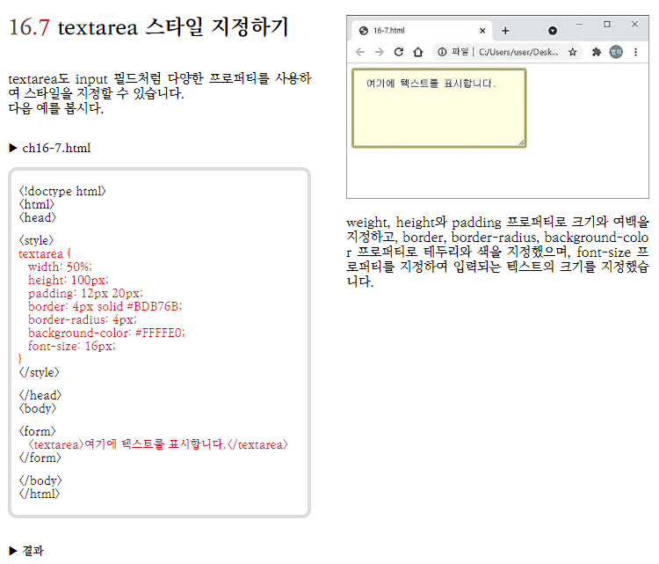

Slide 14
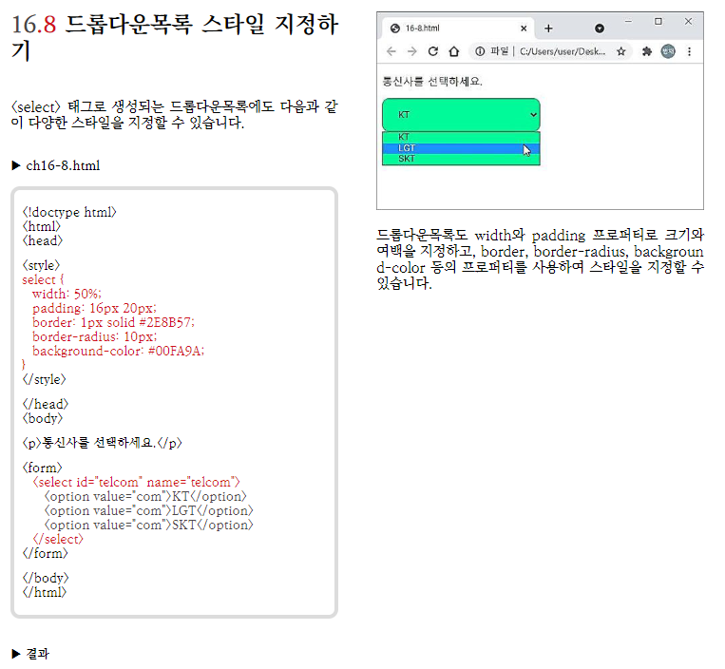

Slide 15
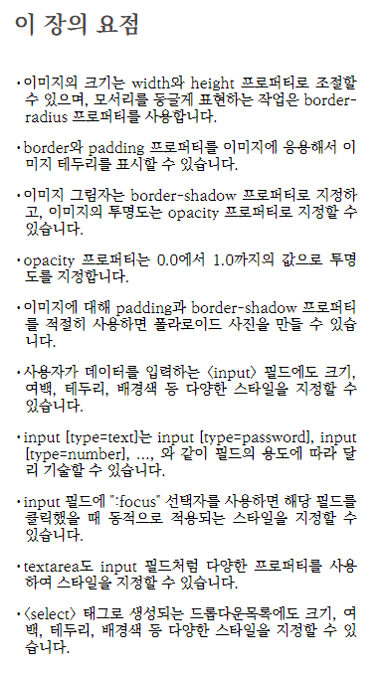

Slide 16
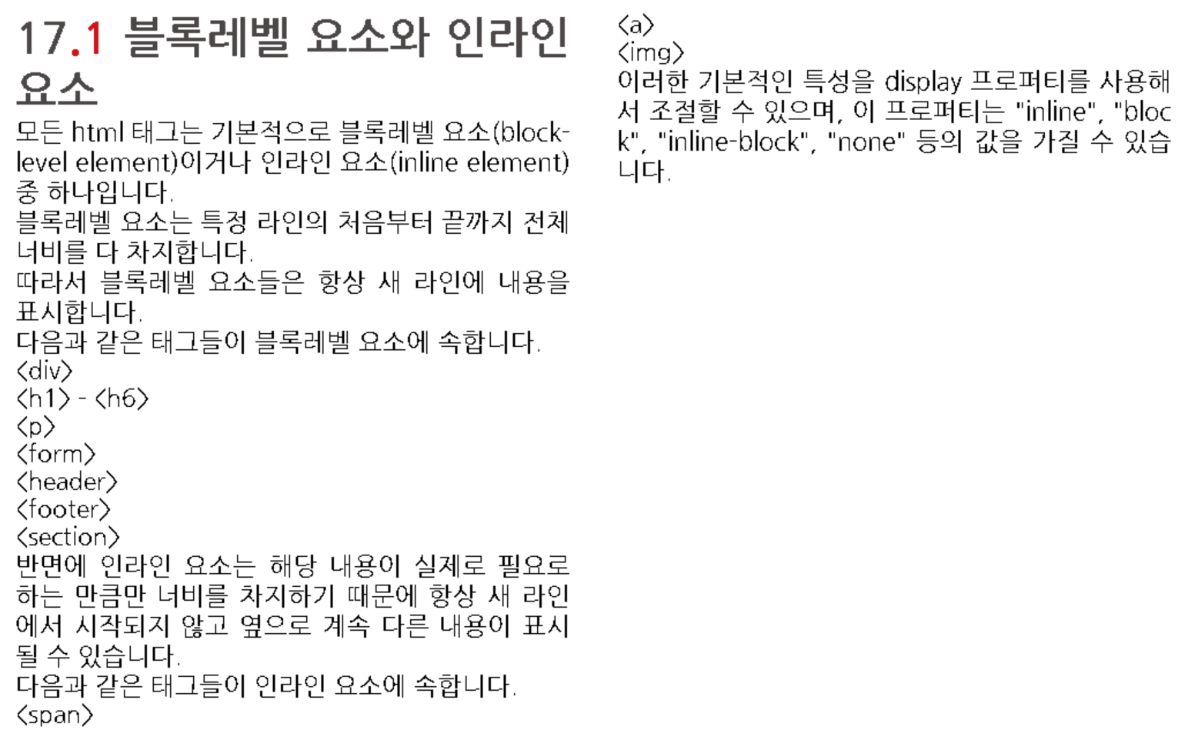

Slide 17
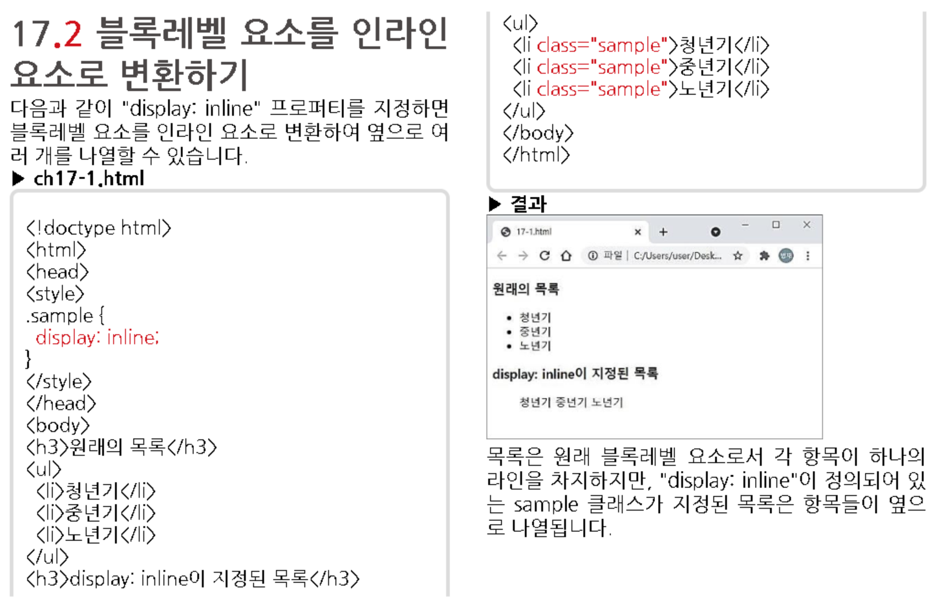

Slide 18
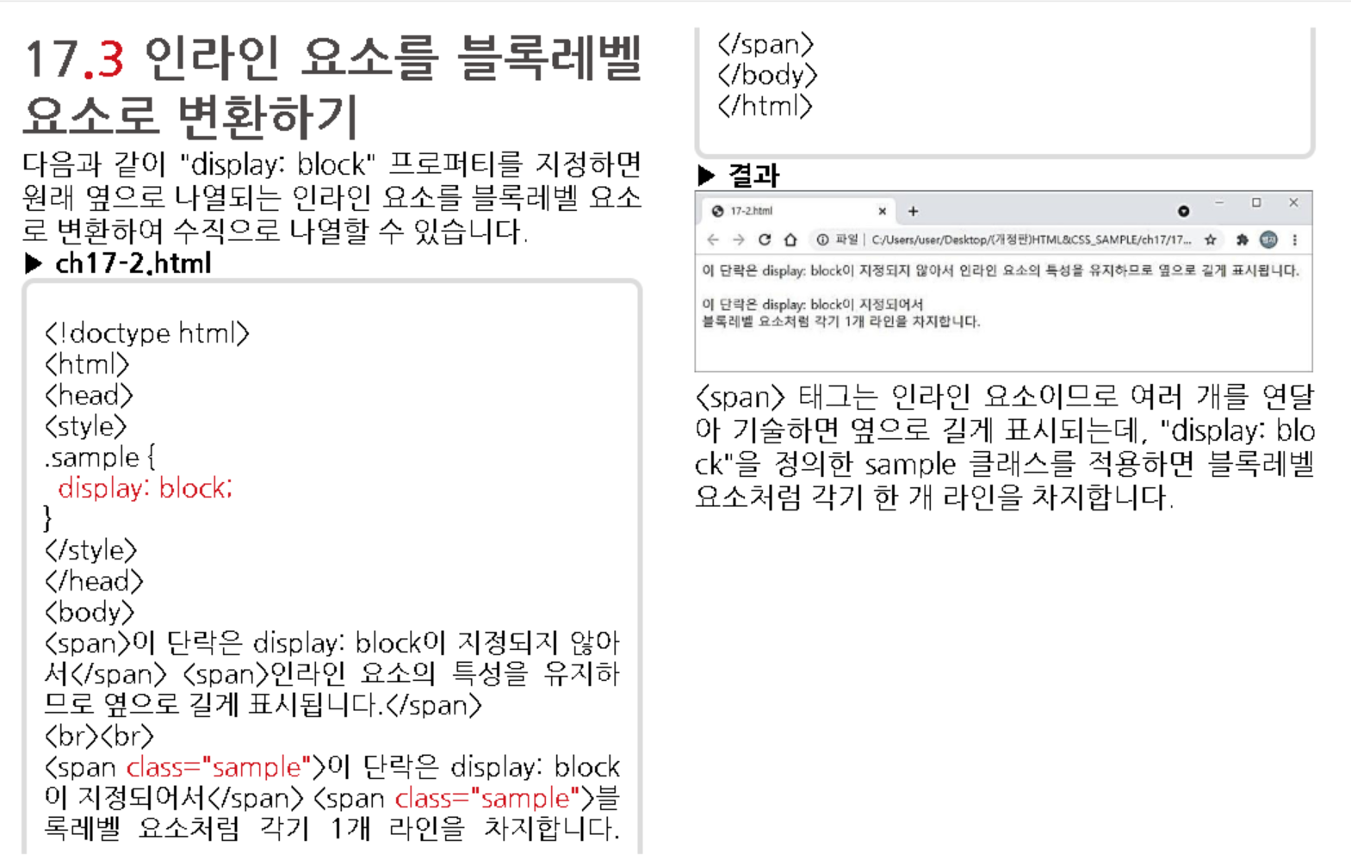

Slide 19
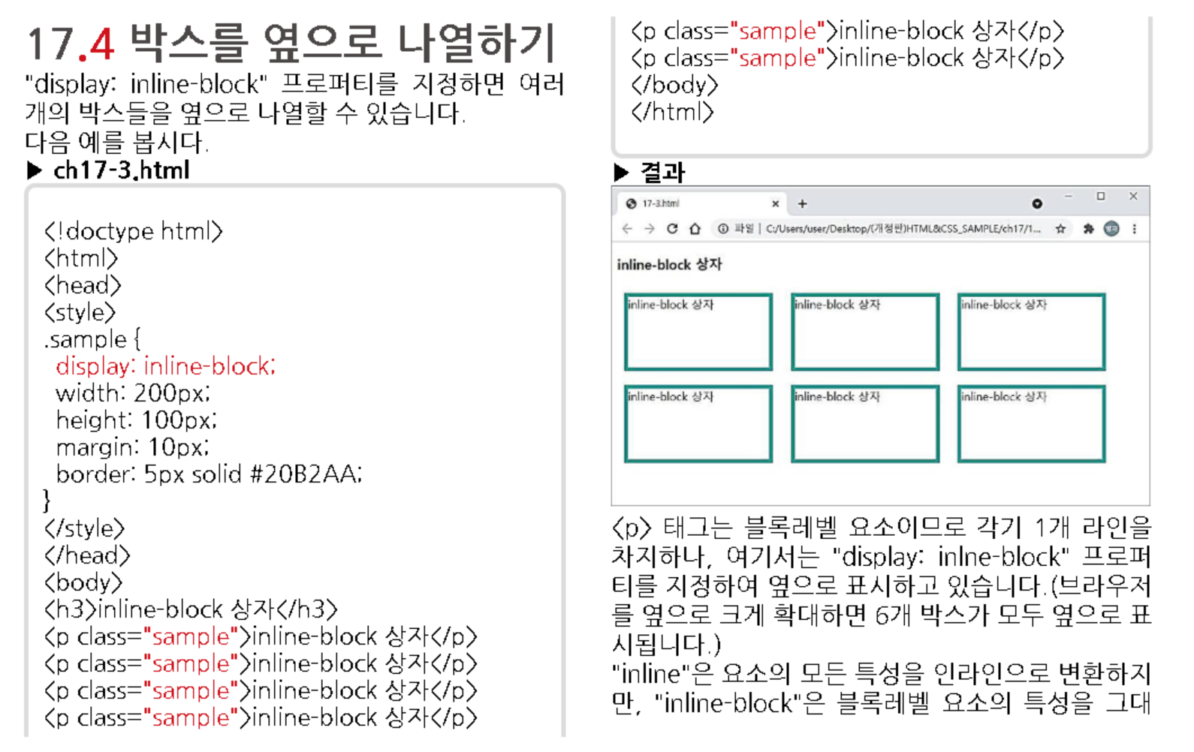
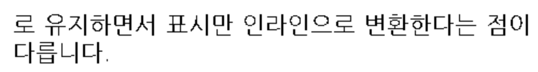

Slide 20
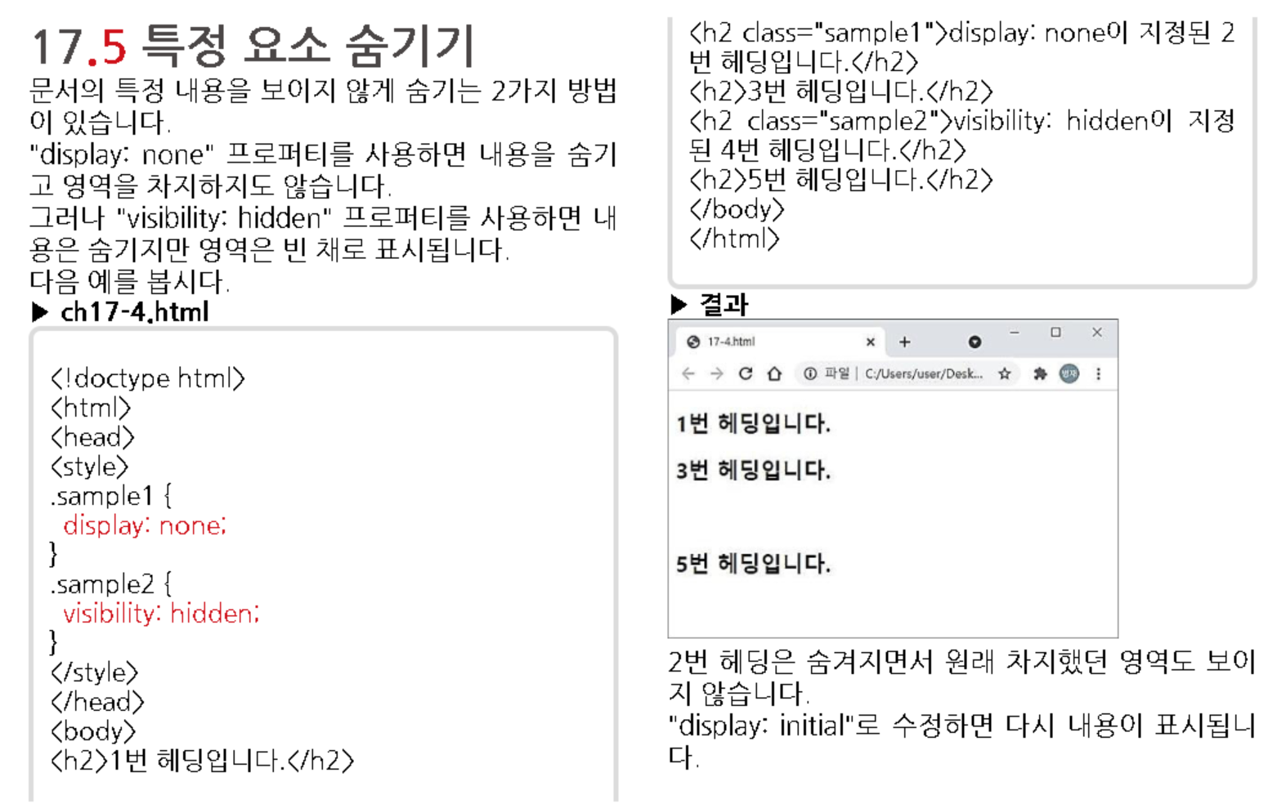
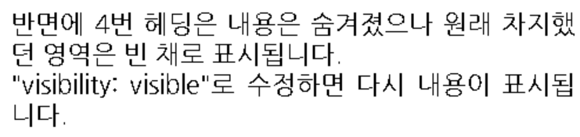

Slide 21
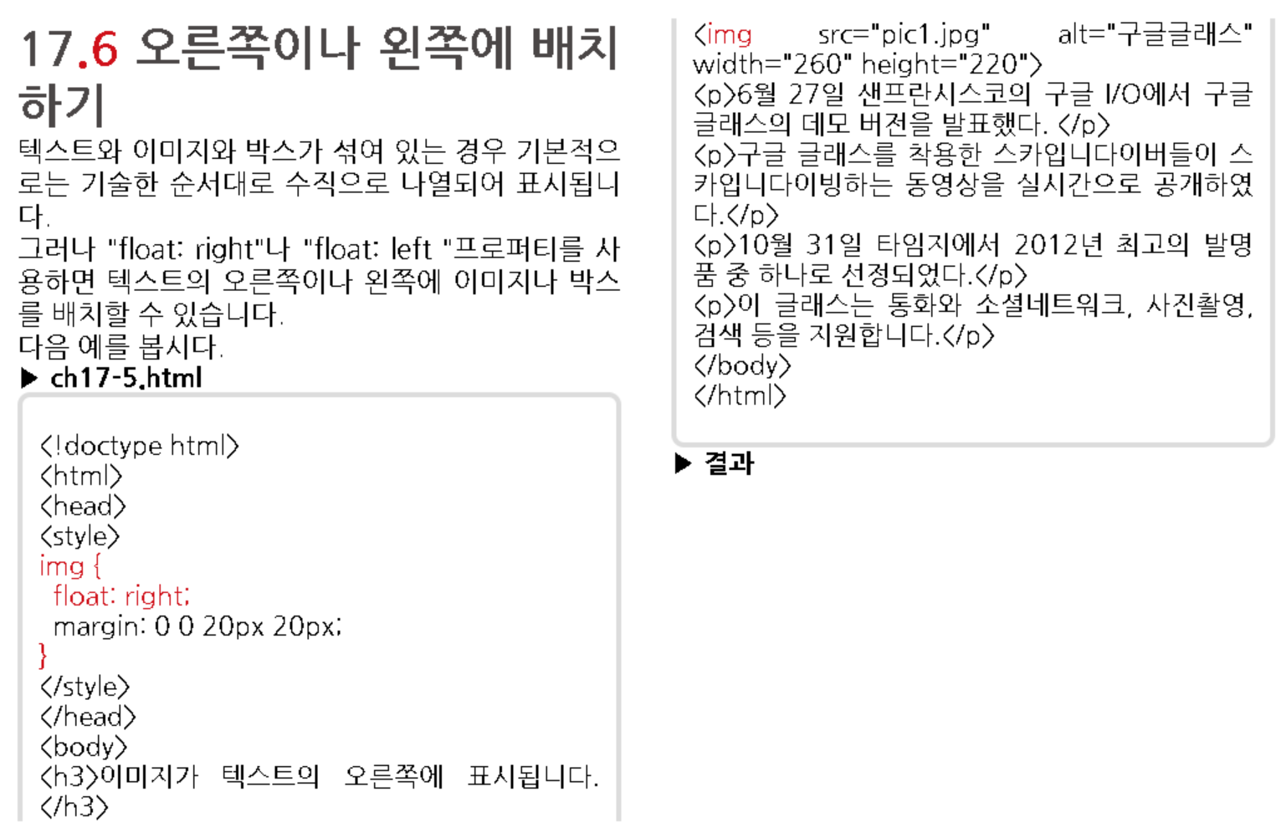
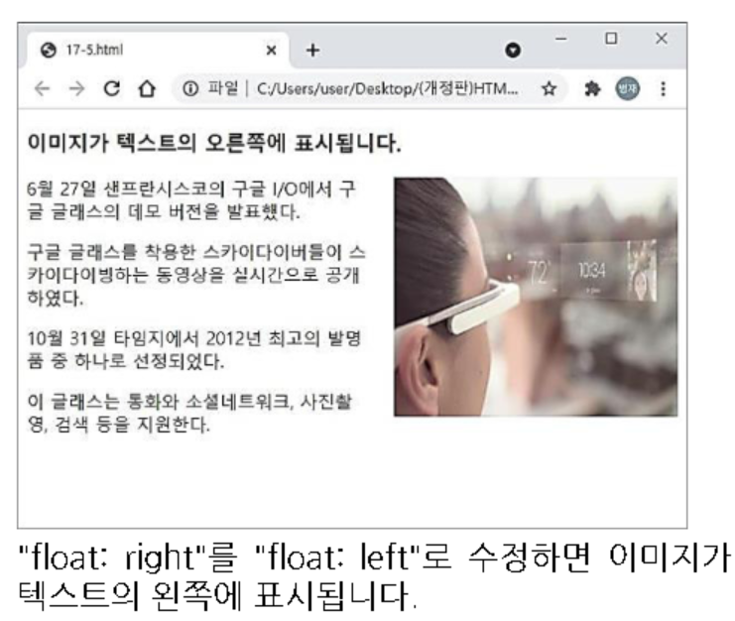

Slide 22
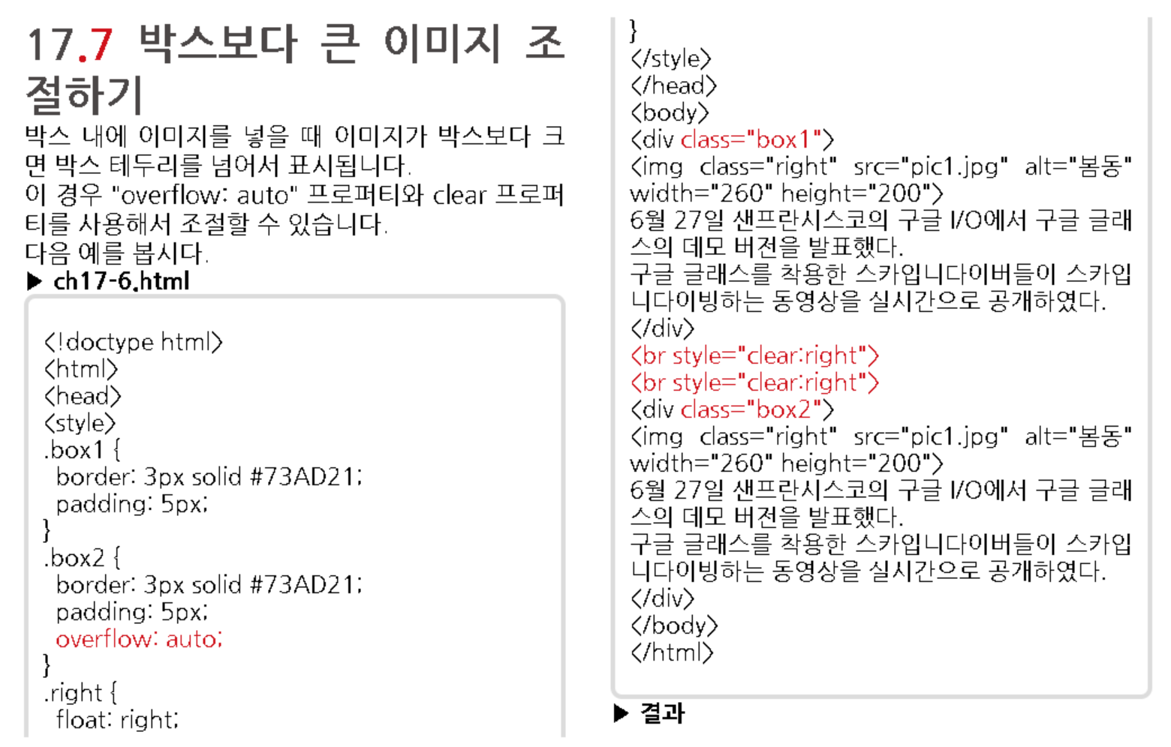

Slide 23
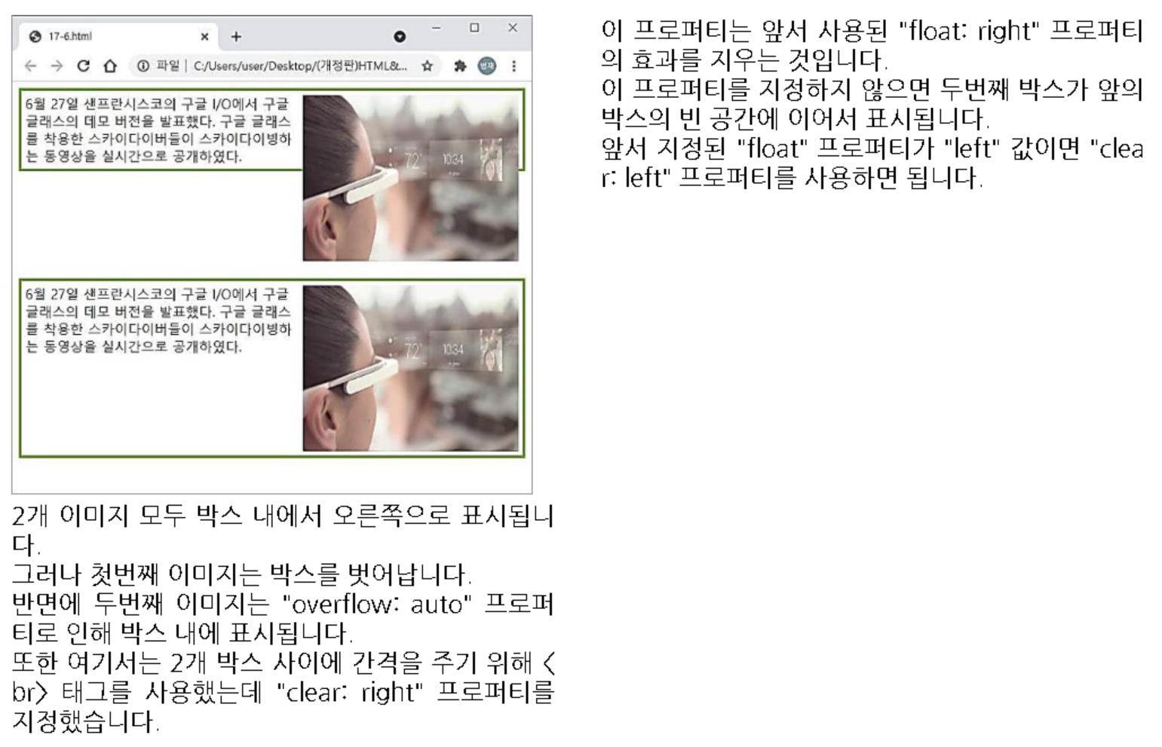

Slide 24
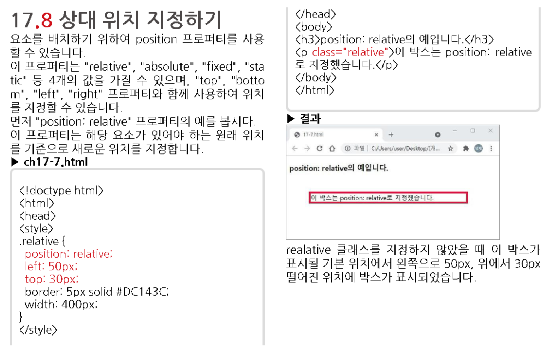

Slide 25
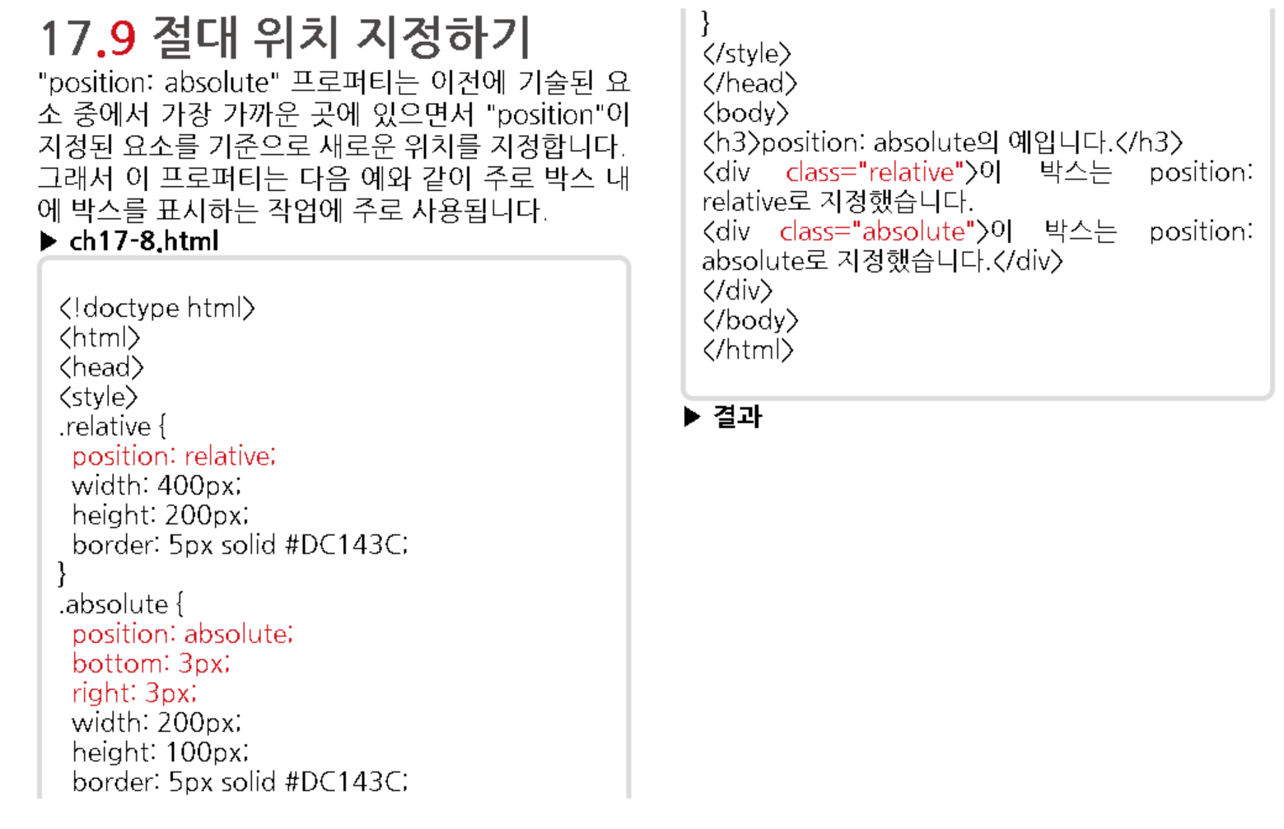
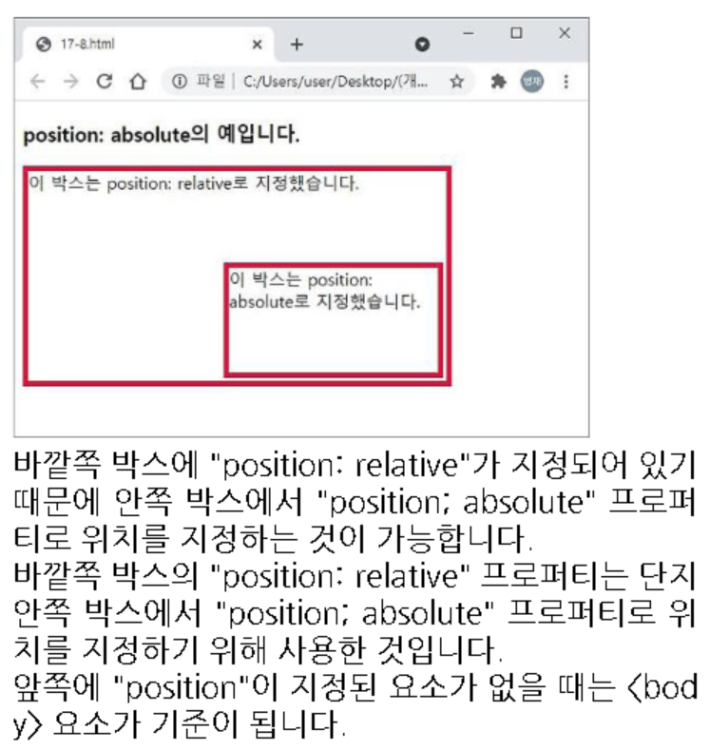

Slide 26
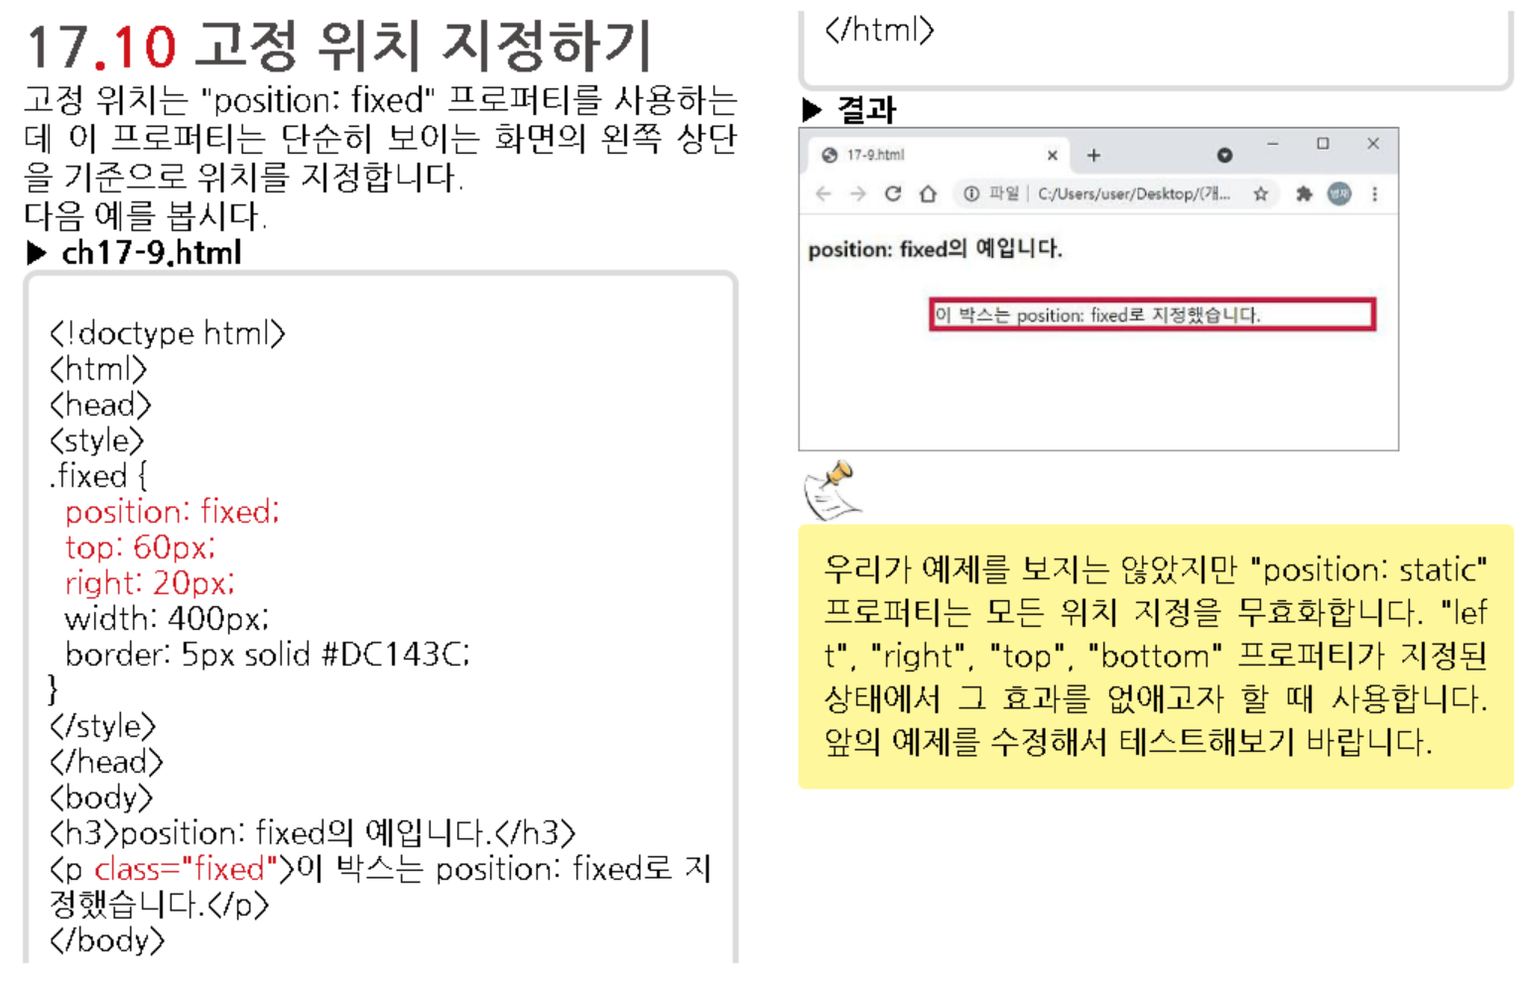

Slide 27
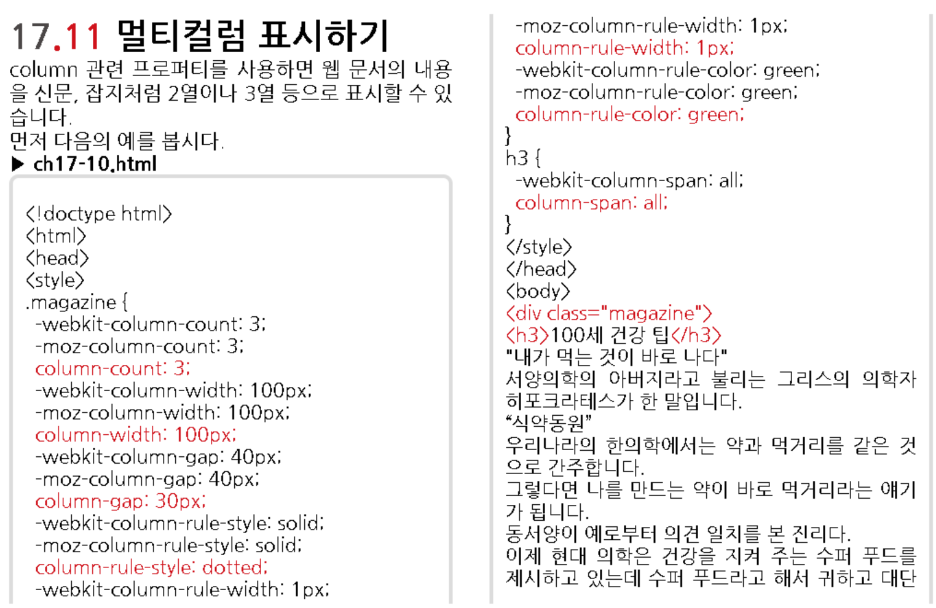

Slide 28
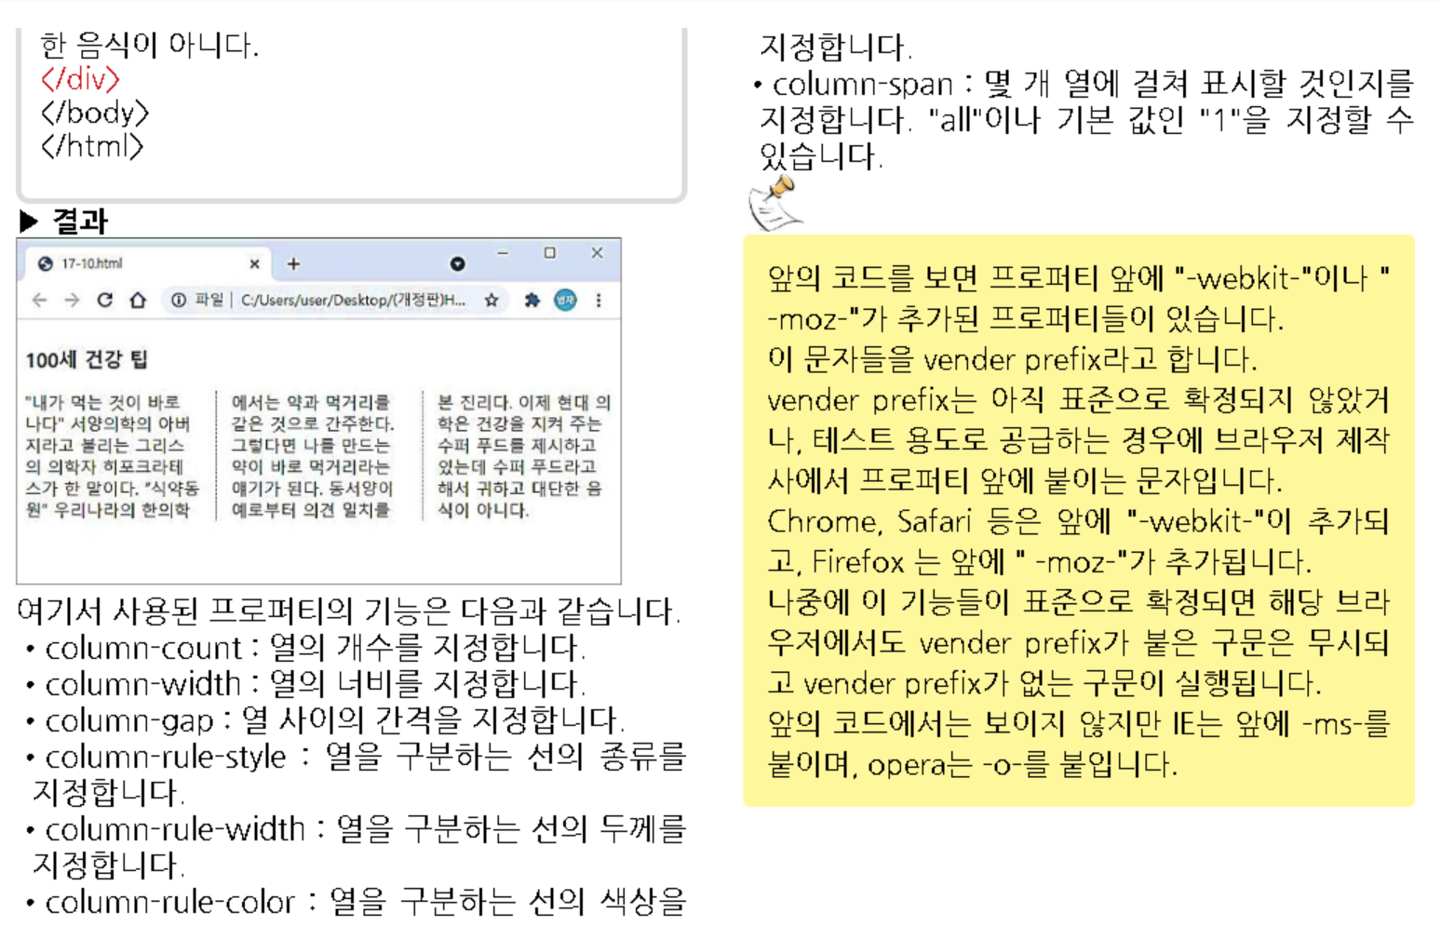

Slide 29
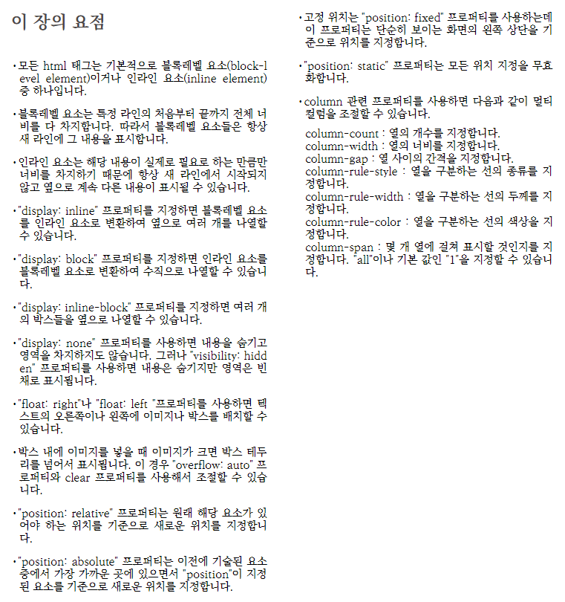

Slide 30



Slide 31


